Slide 1

Dataiku Data Scientist Technical Assessment
Jan Gröls
10.10.2025

Slide 2






Predicting Income Category from Demographic and Employment Data
Objective: Develop a predictive model to classify individuals as earning
≤50K or >50K per year.
Data: Extracted from the U.S. Census Bureau database.
Use case: Identify socioeconomic patterns and drivers of income inequality.
Binary classification problem — predicting if income is:
<= $50K (Binary classifier 0)
or > $50K (Binary classifier 1)

Slide 3


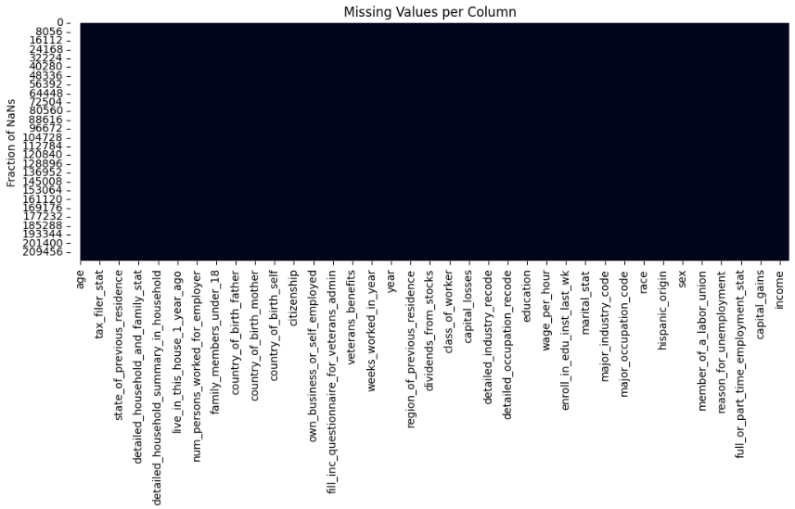
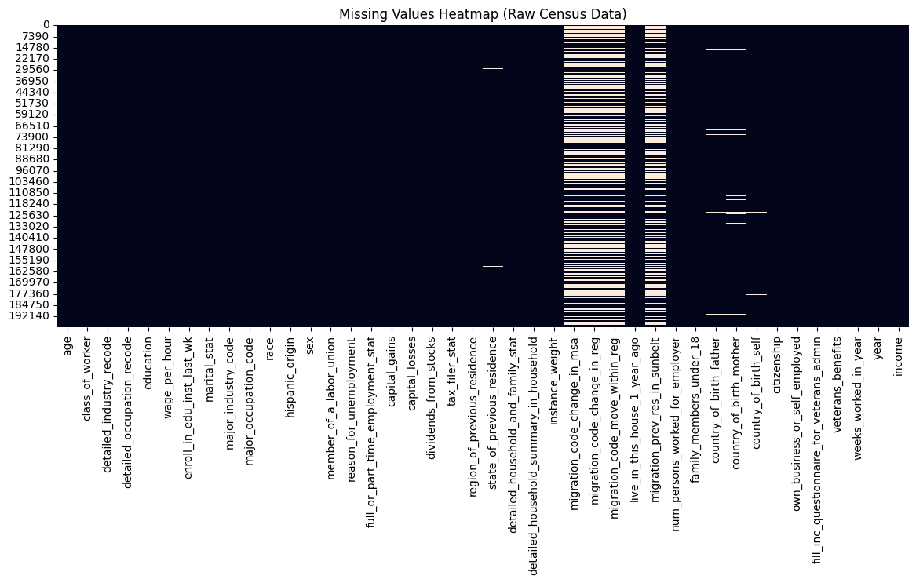
Data Cleaning and Preparation Pipeline
Removed missing and inconsistent entries ("?" placeholders).
Dropped:
Irrelevant columns (highly null variables)
Duplicate rows (both target classes)
Columns to ignore (instance_weight)

Slide 4
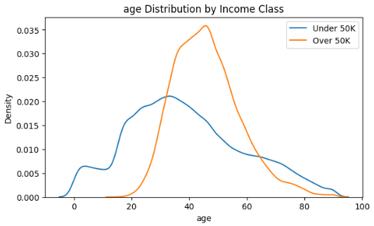
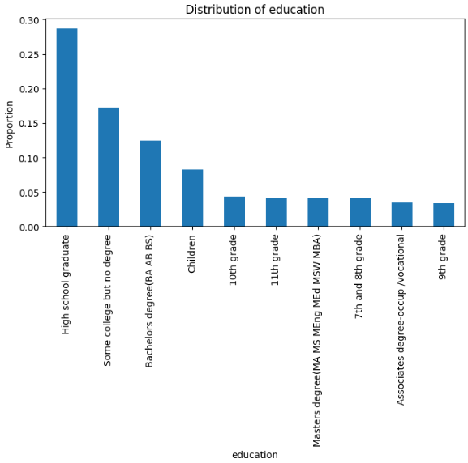
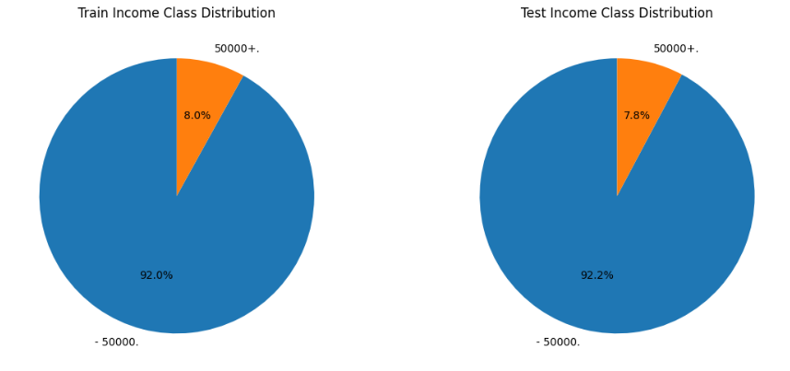
Insights from Exploratory Data Analysis
Age and weeks worked per year strongly correlate with income.
Capital gains and dividends show heavy right-skew (most near 0).
Gender and education level show distinct income distributions.
Majority of individuals fall under ≤50K income bracket.

Slide 5
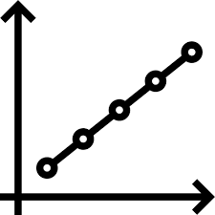
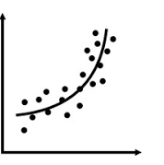
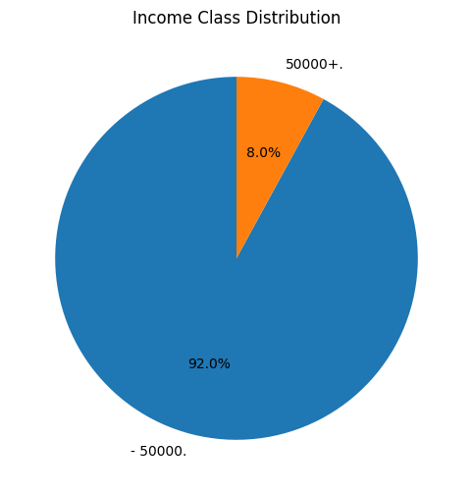

Model Training & Hyperparameter tuning
Quick scan of 5 algorithms for training and comparison:
Logistic Regression
Decision Tree
Random Forest
Gradient Boosting
XGBoost
Used GridSearchCV (5-fold CV) with ROC AUC and F1 Macro metrics.
Instructions via YAML file
F1 helpful as data is very skewed
Automated pipeline with preprocessing + model in a single Pipeline (run.py).
VS
F1 combines precision and recall, giving balanced measure of performance on the minority class.

Slide 6

Model evaluation and performance metrics
Model | ROC AUC | F1 Macro
XGBoost | 0.946 | 0.785
Gradient Boosting | 0.941 | 0.767
Random Forest | 0.931 | 0.741
Logistic Regression | 0.933 | 0.687
Decision Tree | 0.877 | 0.675
Insights:
XGBoost achieved the best balance between precision and recall.
Ensemble methods (GB, RF, XGB) clearly outperformed linear models.
Technical (i.e., regularisation)
Performance
Statistical (i.e., non-linear patterns)

Slide 7
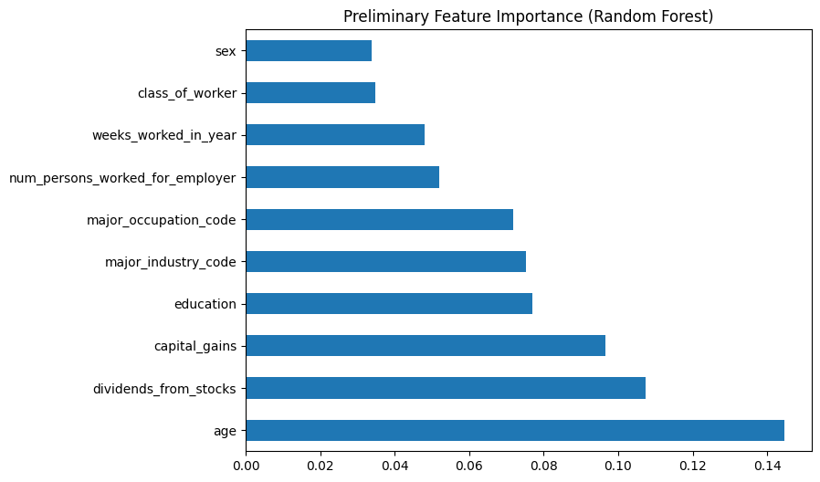





Key Insights & Learnings
Data cleaning and preprocessing are critical for model stability.
Ensemble models (especially XGBoost) generalise best.
Feature importance highlights age, stock dividends, and capital gains as top predictors.
Automated pipeline ensures reproducibility and scalability.

Slide 8
Next Steps and Future Improvements
Add feature selection or dimensionality reduction (PCA).
Try advanced ensembles (e.g., Stacking or LightGBM).
Include external socioeconomic features (e.g., region-level data).
Optimise runtime with smaller grids or randomised search.
Deploy as a lightweight API for predictions.

